Slide 1


GEETHANJALI COLLEGE OF ENGINEERING AND TECHNOLOGY Cheeryal(v), Keesara(m), Medchal(Dist.),501301(T.S)
DETECTION OF PHISHING WEBSITES USING MACHINE LEARNING
BY
SANJAY GOUD-20R11A6609
BHUVAN -20R11A6608
SAI KUMAR -21R15A6601
GUIDE-K.SIVA RAMA KRISHNA(ASSOC.PROF)

Slide 2
OVERVIEW
Abstract
Introduction
Data Collection
Methodology
Existing System
Proposed System
Implementation
Conclusion
References

Slide 3
ABSTRACT
Phishing attack is a simplest way to obtain sensitive information from innocent users. Aim of the phishers is to acquire critical in-formation like username, password and bank account details. Cybersecurity persons are now looking for trustworthy and steady detection techniques for phishing websites detection. This project deals with machine learning technology for detection of phishing URLs by extracting and analyzing various features of legitimate and phishing URLs. Decision Tree, random forest Support vector machine, gradient boosting classifier, multilayer perceptons and logestic regression algorithms are used to detect phishing websites. Aim of the project is to detect phishing URLs as well as narrow down to best machine learning algorithm by comparing accuracy. And also we develop a GUI to detect phishing URL.

Slide 4

INTRODUCTION
In this world everyone is accessing the internet for different purpose. As the internet grew; there are some problems like stealing data, hacking and fake web pages came into being. To get rid of these phishing websites ‘phishing website detection website’ is very useful. It helps users to understand what phishing is and how to stay safe while surfing the internet, because people use their personal information like and account details.
(Source: Designed by Freepik, n.d.)

Slide 5
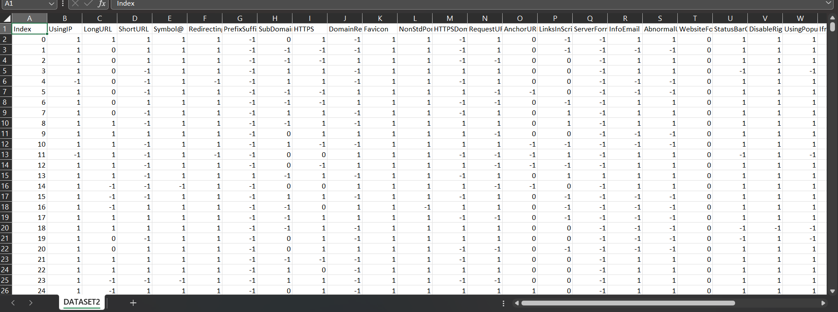
DATA COLLECTION
The dataset is borrowed from Kaggle, https://www.kaggle.com/eswarchandt/phishing-website-detector .
The overview of this dataset is, it has 11054 samples with 32 features.

Slide 6

Image of Cyber attack Counter-measure (Source: Designed by Freepik, n.d.)

Slide 7


METHODOLOGY
An extensive review was done on existing works of literature and machine learning models on detecting phishing websites to best decide the classification models to solve the problem of detecting phishing websites.
Data Collection

Slide 8
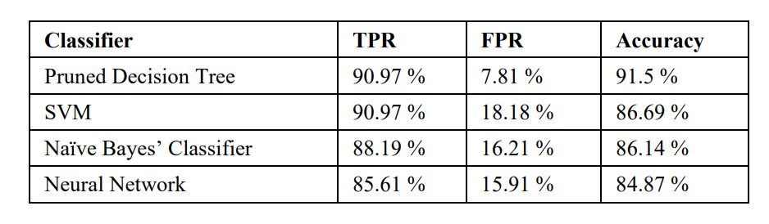
EXISTING SYSTEM
Architectural design of proposed system zx

Slide 9
PROPOSED SYSTEM
The proposed phishing detection system utilizes different machine learning models. The system comprises of two major parts, which are the machine learning models and a GUI. These models consist of Decision Tree, Support Vector Machine, XGBooster, Multilayer Perceptrons, Logistic Regression , Random Forest and Gradient Boosting
These models are selected after different comparison based performance of multiple machine learning algorithms. Each of these models is trained and tested also extracted from both phishing and legitimate dataset.
Hence, the model with the highest accuracy is selected and integrated to a GUI that will enable a user to predict if a URL link is phishing or legitimate with percentage.

Slide 10
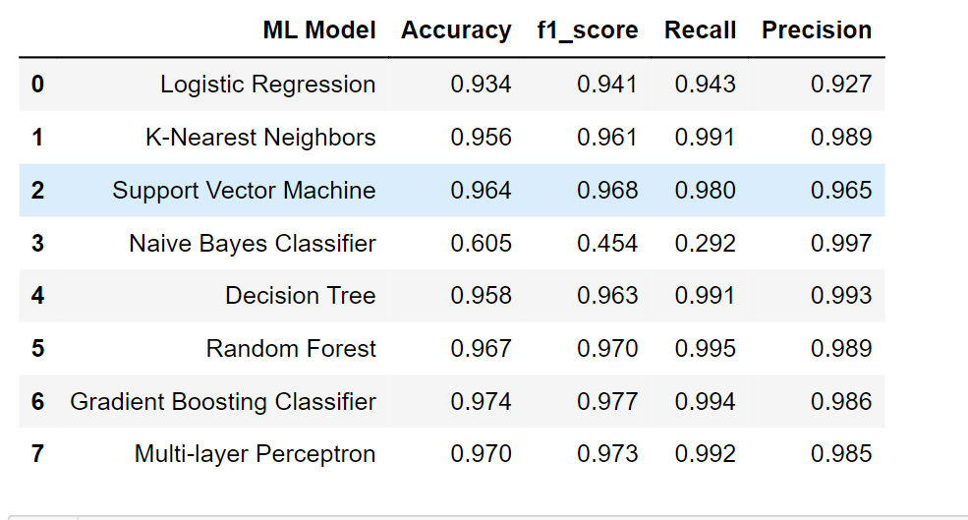
MODEL EVALUATION
The models are evaluated, and the considered metric is accuracy. Below Figure shows the training and test dataset accuracy by the respective models:

Slide 11
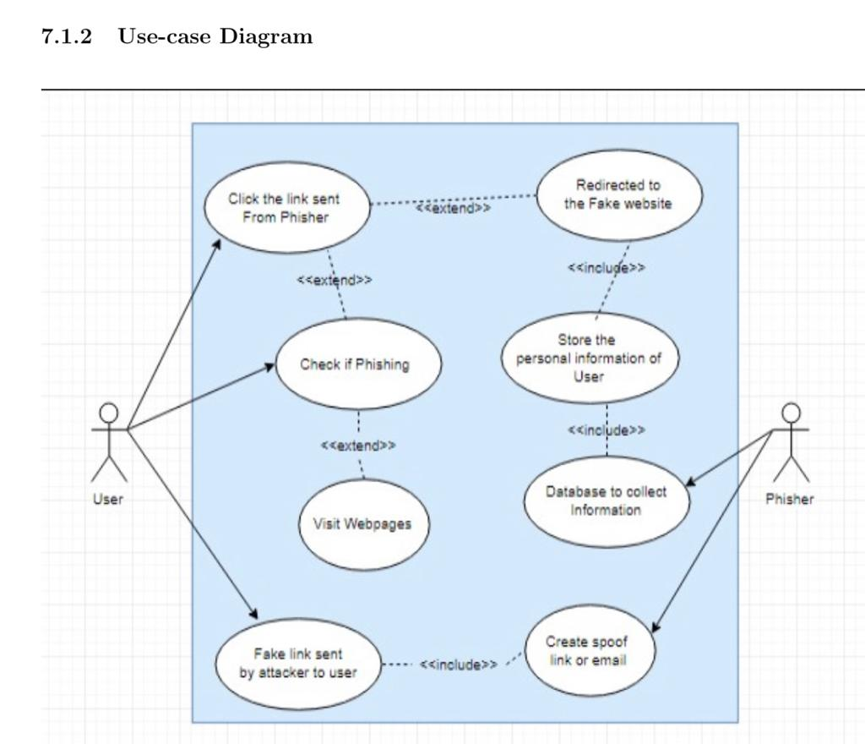
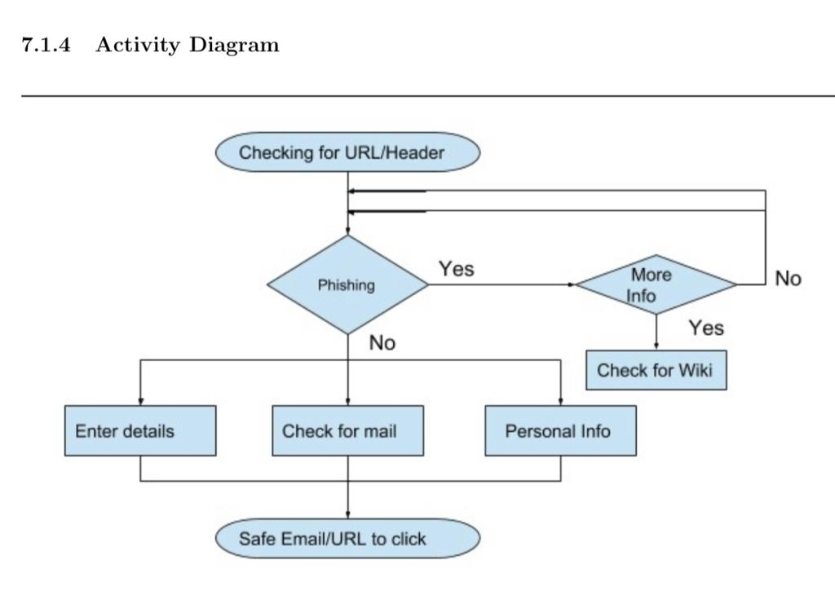

Slide 12
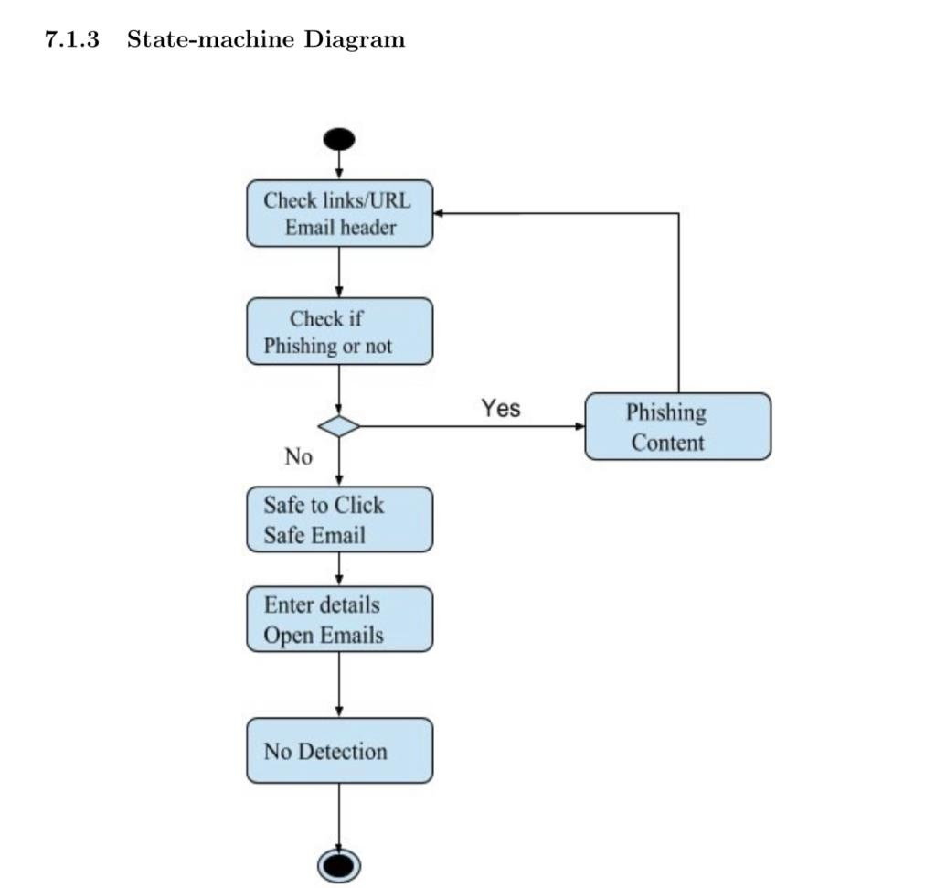

Slide 13
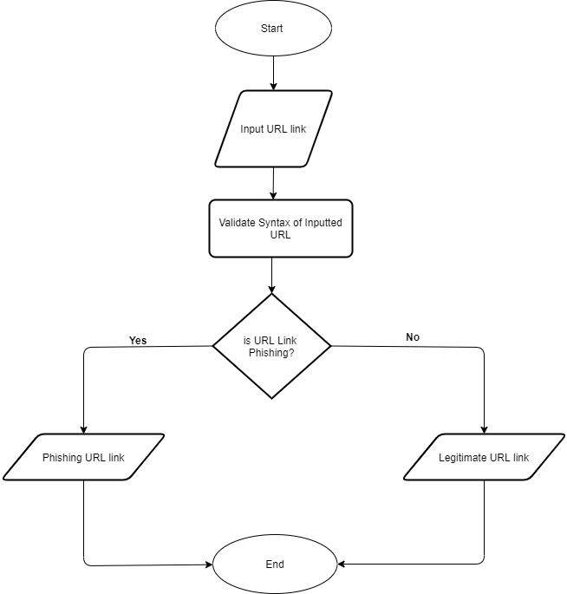
Flowchart of GUI Application

Slide 14

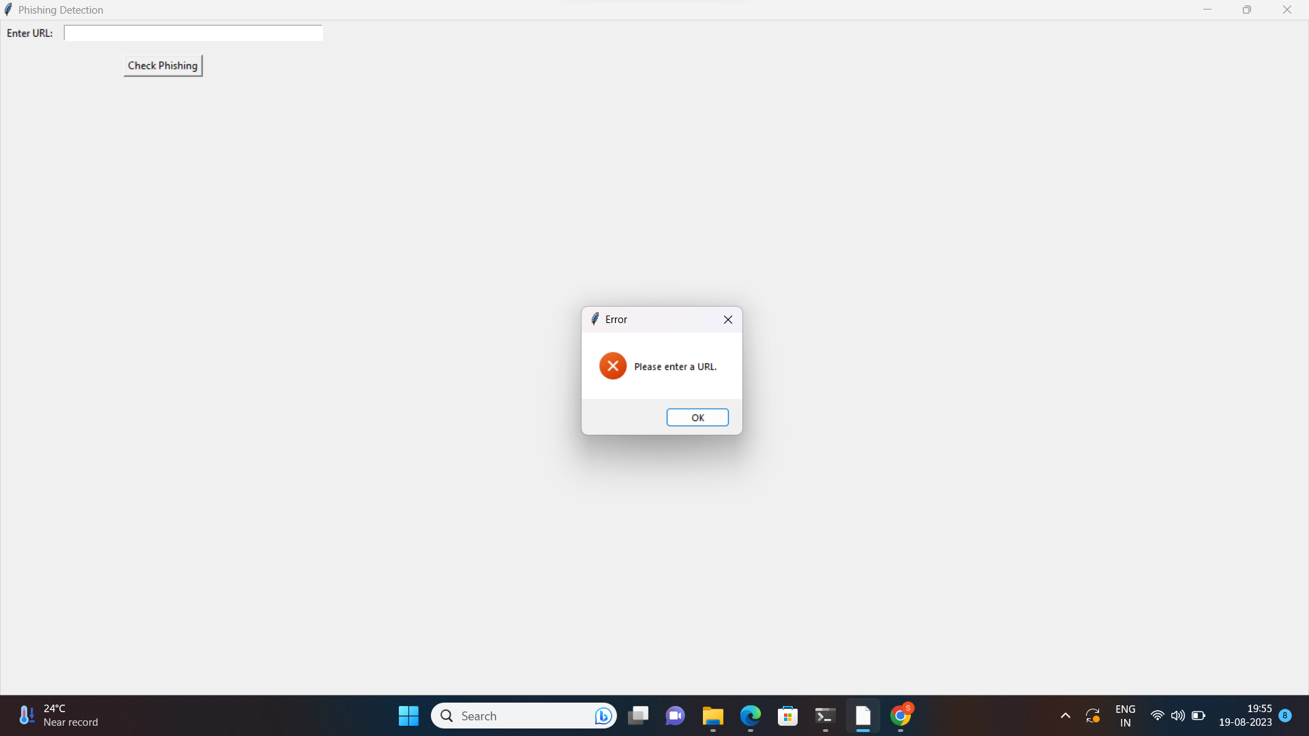
IMPLEMENTATION

Slide 15
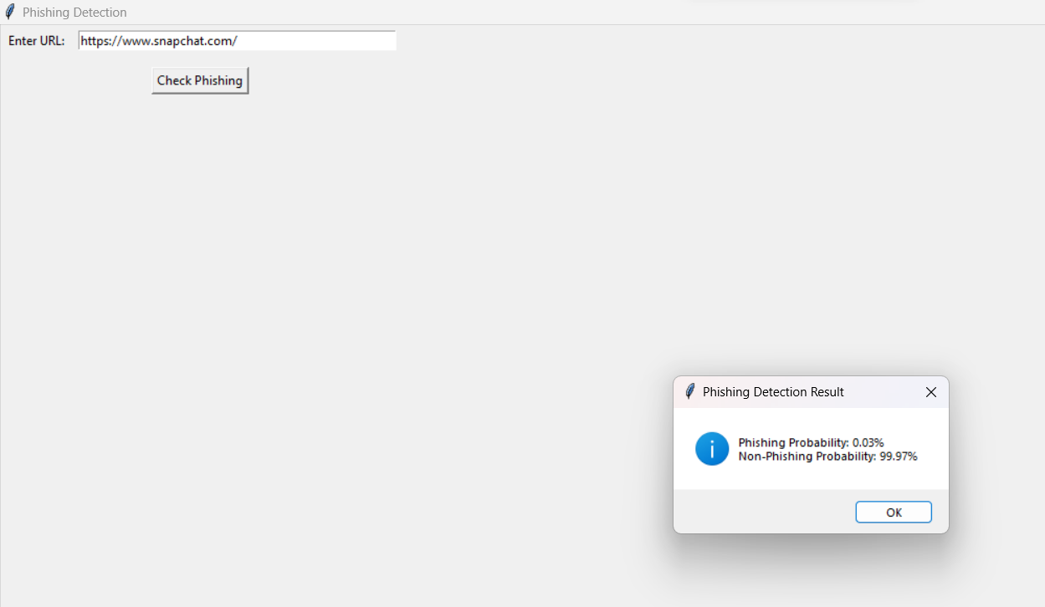
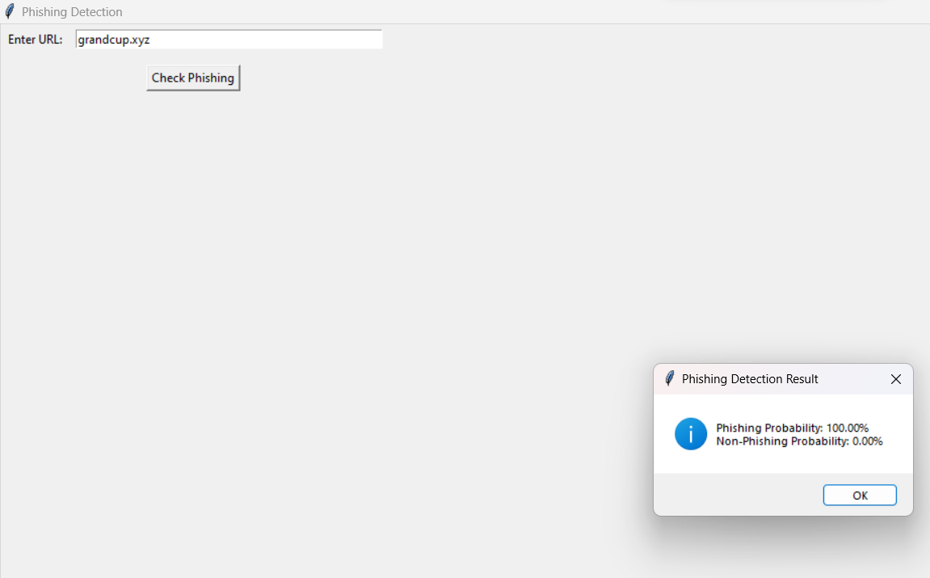

Slide 16
CONCLUSION
The contribution of this research work is to help both individuals and organization identify and understand phishing techniques used by phisher as well as help them detect phishing URL attack effectively and efficiently by employing machine learning models instead of the previous method of detecting phishing website.

Slide 17
REFERENCES
Y. Daeef, R. B. Ahmad, Y. Yacob and N. Y. Phing, ”Wide scope and fast websites phishing detection using URLs lexical features,” 2016 3rd International Conference on Electronic Design(ICED), Phuket,2016, pp. 410-415. doi:10.1109/ICED.2016.7804679
N. Sanglerdsinlapachai and A. Rungsawang, ”Using Domain Toppage Similarity FeatureinMachineLearning BasedWebPhishingDetection,”2010ThirdInternational
Conference on Knowledge Discovery and Data Mining, Phuket, 2010, pp. 187- 190. doi:10.1109/WKDD.2010.108.
S. Parekh, D. Parikh, S. Kotak and P. S. Sankhe, ”A New Method for Detection of Phishing Websites: URL Detection,” 2018 Second International Conference on Inventive Communication and Computational Technologies (ICICCT), Coimbatore, 2018, pp. 949- 952.doi:10.1109/ICICCT.2018.8473085.

Slide 18

THANKS FOR LISTENING

